Slide 1

Spotify Song Popularity Prediction
PRESENTED BY: Mohammed Shabas c s
DATA SCIENCE/ MACHINE LEARNING PROJECT

Slide 2
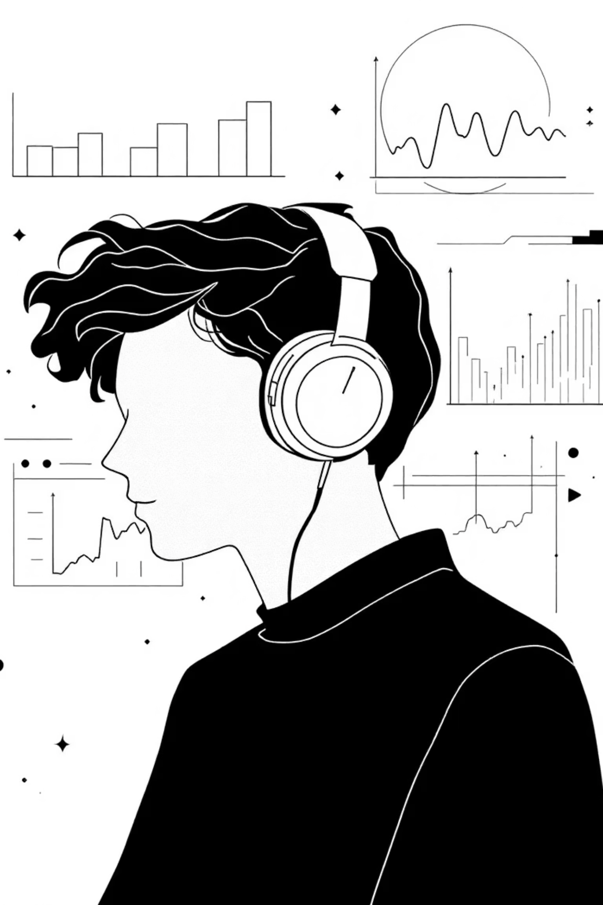
Introduction
Spotify hosts millions of songs, and understanding what makes a track popular is highly valuable for artists, music labels, streaming platforms, and advertisers. Predicting song popularity using machine learning helps identify key factors that influence a song's success across digital platforms.
This project analyzes extensive song-level data, including Spotify streams, playlist metrics, TikTok engagement, YouTube views, Shazam counts, and more, to build a model that predicts whether a song will become popular or not popular.

Slide 3

Project Objectives
Analyze Metrics
Identify key song-related metrics and factors influencing popularity.
Build ML Models
Develop machine learning models to predict track popularity.
Compare Algorithms
Evaluate and select the best-performing predictive model.
Provide Insights
Offer actionable insights for music labels and creators to optimize strategies.

Slide 4










Defining Song Popularity & Data Foundation
Song popularity refers to how widely a song is streamed, shared, or interacted with across various digital platforms such as Spotify, YouTube, TikTok, and Shazam.
Streaming-based
Social-based
Discovery-based
Spotify Streams, Soundcloud Streams
TikTok posts, likes, views
Shazam Counts
Curated-based
Radio-based
Playlist Reach
AirPlay Spins, SiriusXM Spins
Data Collection & Models Used
Purpose: To analyze multi-platform engagement data to classify songs into popular (1) and not popular (0) categories using machine learning.
Models Used:
XGBoost Classifier
Dataset Includes:
Random Forest Classifier
Spotify Streams & Popularity
Gradient Boosting
Spotify Playlist Count & Reach
Logistic Regression
YouTube Views & Likes
An intuitive Gradio App allows users to predict song popularity by entering track statistics.
TikTok Posts, Likes, Views
Shazam Counts
Pandora & Deezer Stats
Explicit Tag
Track Score, All-Time Rank

Slide 5






Project Workflow: From Raw Data to Prediction
1. Data Collection
Download Spotify multi-platform dataset from a reliable source.
2. Data Cleaning
Remove commas, hyphens. Convert numerical strings to numeric. Handle missing values (median imputation). Drop useless text columns (Track name, Artist, Album).
3. Data Preprocessing
Label encode "Explicit Track". Create target variable: popular = 1 if streams >= median else 0. Train–Test Split. Scaling for Logistic Regression.
4. Feature Selection
Identified most important features: Spotify Playlist Reach, Spotify Playlist Count, YouTube Views, TikTok Views, Shazam Counts, Spotify Popularity.
5. Model Selection
Tested: XGBoost, Random Forest, Logistic Regression.
6. Model Training & Evaluation
Evaluate models using accuracy, F1-score, confusion matrix, and comparison charts.

Slide 6
Dataset Snapshot
A preview of the dataset used, illustrating the diverse metrics captured for each song.
All Time Rank
Track Score
Spotify Streams
Playlist Count
Playlist Reach
Spotify Popularity
YouTube Views
TikTok Views
Shazam Counts
Explicit Track
Popular
1
95
1.5B
1200
250M
89
500M
1.2B
15M
False
1
5
88
800M
900
180M
85
300M
900M
10M
True
1
12
70
300M
350
70M
75
100M
250M
3M
False
0
2
92
1.1B
1100
220M
87
450M
1.0B
13M
False
1
20
65
150M
200
40M
68
50M
120M
1.5M
True
0

Slide 7
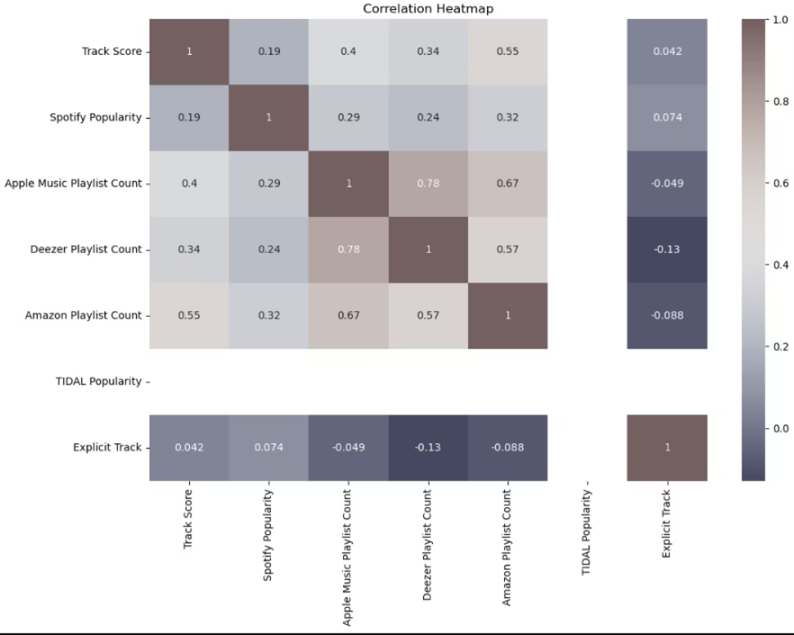
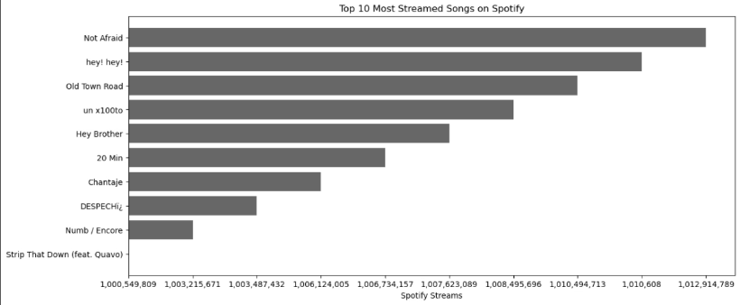
Key Visualizations & Model Performance
Exploratory Data Analysis (EDA)
displays the Top 10 most-streamed songs on Spotify, ranked by their total stream counts. It visually compares which songs have achieved the highest global streaming numbers, highlighting their popularity and listener reach.
The correlation heatmap visualizes the relationships between key song metrics such as track score, playlist counts, and popularity. Strong positive correlations (e.g., between Apple Music and Deezer playlist counts) indicate platforms that behave similarly. Explicit Track has almost no correlation with popularity or playlist metrics, meaning explicit songs don’t significantly affect popularity.
Model Results
92.3%
90.9%
XGBoost Classifier
Random Forest
Testing Accuracy: 92.3%, F1 Score: 0.92
Testing Accuracy: 90.9%, F1 Score: 0.91
78%
Logistic Regression
Testing Accuracy: ~78%

Slide 8
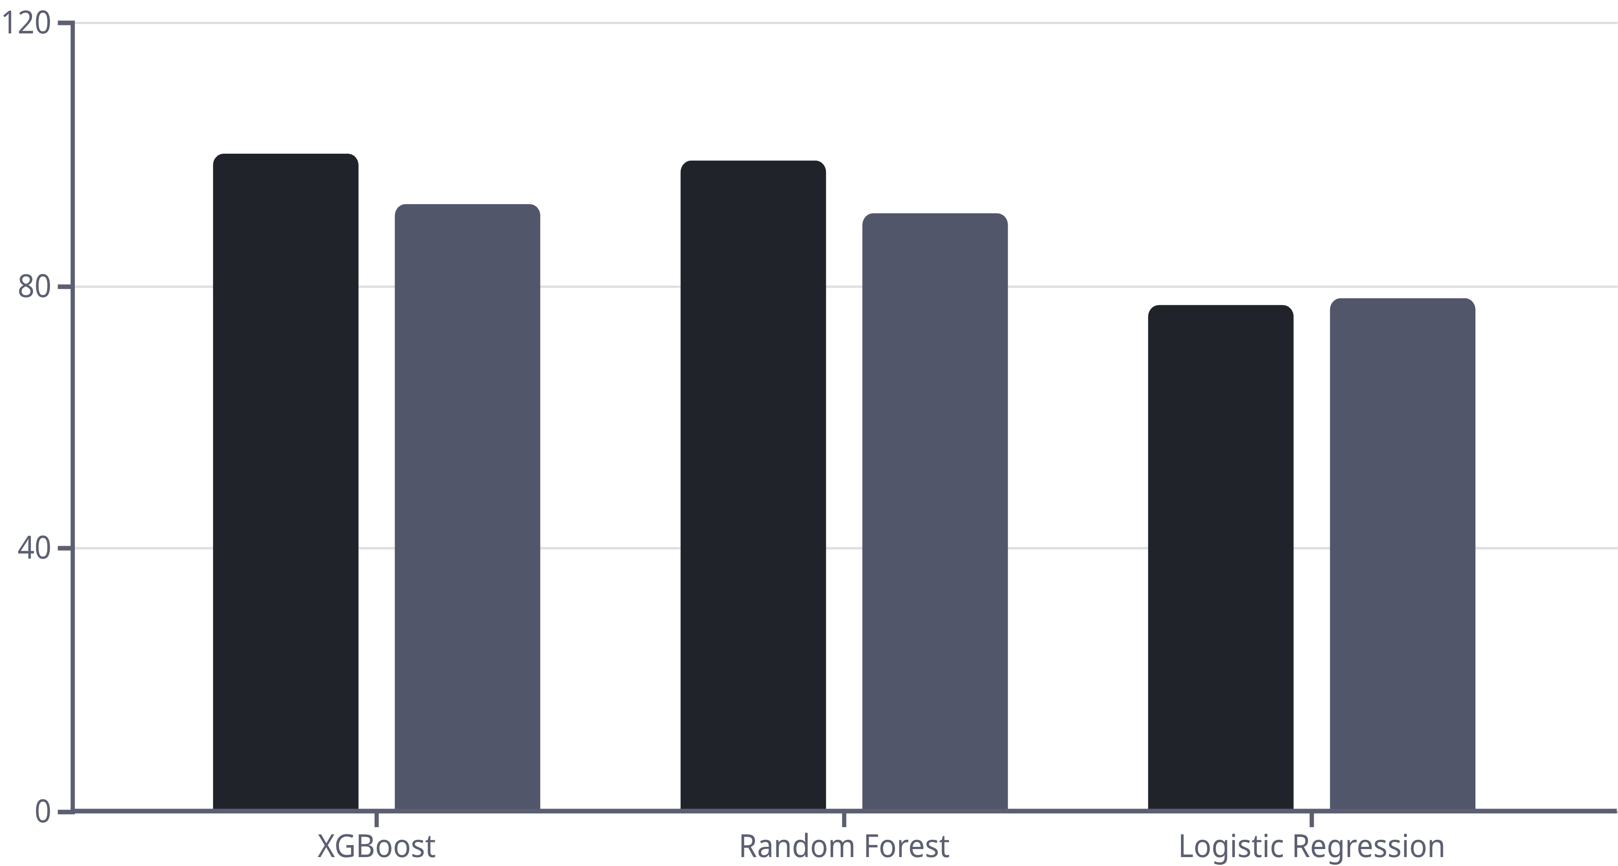
Model Comparison and User Interface
Performance Overview
XGBoost
100%
92.3%
0.92
Random Forest
98–100%
90.9%
0.91
Logistic Regression
77%
76–80%
0.78
Training Accuracy
Testing Accuracy
Interactive User Interface: Gradio App
The custom-built Gradio application offers an intuitive interface for real-time popularity prediction.
Users input key metrics like Spotify Playlist Reach, YouTube Views, TikTok Likes, Shazam Counts, and explicit content status, receiving an instant prediction: "Popular Song" or "Not Popular Song."

Slide 9

Future Enhancements & Key Insights
Future Improvements
Audio Features Integration: Incorporate Spotify API data such as tempo, danceability, and valence for richer analysis.
Real-time Data Streams: Integrate live data from TikTok and YouTube APIs to capture evolving trends.
Refined Prediction: Develop a model to predict a continuous popularity score instead of binary classification.
Recommendation Engine: Build a sophisticated recommendation system based on predicted popularity.
Deployment Optimization: Deploy the application using Streamlit or FastAPI for improved performance and scalability.
Key Insights & Findings
Social Media Influence
Playlist Power
Explicit Content
TikTok and YouTube engagement strongly influence song popularity.
Playlist Reach is one of the biggest drivers of Spotify streams.
Explicit content does not significantly affect popularity.
Cross-Platform Synergy
ML Accuracy
Multi-platform viral behavior is a strong predictor of Spotify success.
Machine learning achieves over 90% accuracy in song classification.

Slide 10

Conclusion: Predicting the Next Big Hit
The Spotify Song Popularity Prediction model successfully classifies songs as popular or not popular with high accuracy, leveraging comprehensive multi-platform metrics.
This project demonstrates the transformative power of data-driven insights and machine learning, offering invaluable guidance for artists, labels, and streaming platforms to predict music success and optimize promotional strategies in an increasingly competitive digital landscape.
Thank You

